Slide 1


Résumés 101
An Introductory Workshop For Résumé Building Basics

Slide 2

Objectives
Today, we will….
Understand the importance of a résumé
Learn the difference between Chronological vs Combination templates
Have an introduction to Applicant Tracking Systems (A.T.S’s)
Learn résumé best practices

Slide 3

Let’s Talk About It…
Résumé writing is hard/frustrating/time-consuming…
Notes:
How are you feeling about résumé building/job search? Acknowledge that résumés are very personal and it can be hard to accept feedback. Talk about/encourage openness about how people are feeling with this process.

Slide 4

The Importance of a Résumé
What is a résumé and why do you need one?
Summary of your work history and skills/qualifications that make you the best candidate for the job
Most jobs ask for you to apply online and most online applications require/request one

Slide 5




Types of Résumés
Chronological: Timeline
Combination: Skills-based
Master: Core

Slide 6

Chronological
Use a chronological résumé when…
You are staying in the same industry
Have a consistent work history (minimal gaps)
You want to highlight job titles or years of experience

Slide 7

Combination/ Skills
Use a combination/skills résumé when…
You are changing your career
You have large (1+ year) gaps in employment
You want to highlight your skills vs. job titles or years of experience

Slide 8

Master/Core
Use a Master/Core Résumé to…
Collect information on ALL of your work history
Combine your skills and your timeline résumé into one running, growing document
Master/Core résumé should be used only for your reference
Notes:
Master/Core resumes: This is a combination of your skills and timeline résumés in one living document. This résumé can and most likely will be 3+ pages long. Should be used only for your own reference and to pull information from for applications and transferable skills

Slide 9






Sections of a Résumé
Skills section would be between professional summary and work history when using a combination/ skills résumé
Introduction/ Heading
Professional Summary
Work History
Education

Slide 10
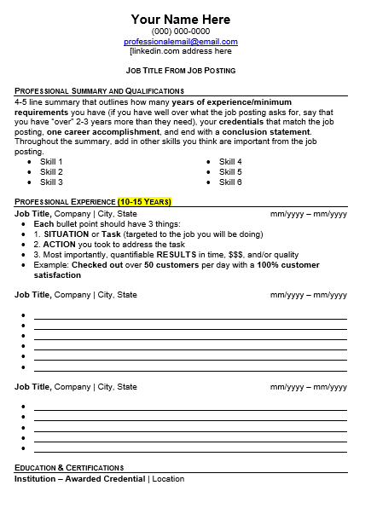
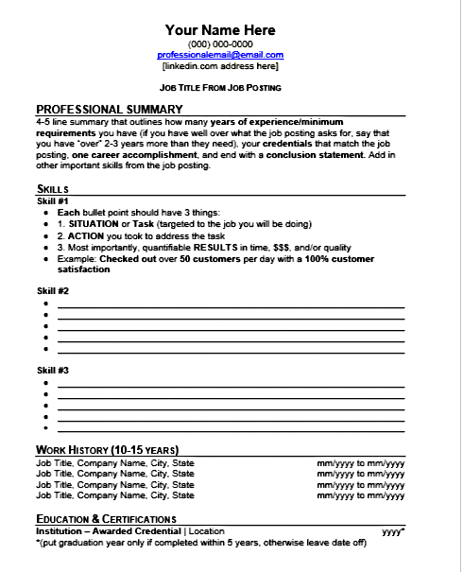

Examples of Chronological and Combination Résumés
Chronological: Timeline
Combination: Skills-based
Notes:
Screen Reader friendly examples of Chronological and Combination Résumés linked under Chronological: Timeline and Combination: Skills-based

Slide 11




Identification/ Heading
Full Legal Name
Phone Number
What to Include
Email Address
LinkedIn Profile/ Personal Website/Portfolio
Notes:
Full Legal Name
(Nicknames/preferred names in “Quotes” in-between first and last name if name is appropriate/ professional)
Phone Number
(Number you will consistently be near i.e., cell phone vs home phone. Check voicemail to make sure there is space and it is up to date)
Email Address
(Make sure email address is appropriate and up to date)
LinkedIn Profile/ Personal Website/Portfolio
(Optional: make sure site is up to date/reflects your résumé)

Slide 12

Professional Summary
4-5 line summary that outlines how many years of experience/minimum requirements you have.
Your credentials that match the job posting, one career accomplishment, and end with a conclusion statement.
Throughout the summary, add in other skills you think are important from the job posting.

Slide 13
Work History
Most recent job to earliest job (going back only 10-15 years)
Job title City, ST 00/0000 to 00/0000
Company name
Use action verbs and concise descriptions
Proper and consistent tenses
Targets the job you are applying for by removing irrelevant information
Highlight Successes: Use data (# $ %)
Notes:
Job title: Make sure your job titles match what HR has on file
City/State: If you were remote, you can either put "remote" and/or put the location of the headquarters of the company
Dates: make sure to put months AND years. I usually recommend using the 00/0000 format vs abbreviations so that they consistently line up in formatting
Company name: If the company changed names, put current company name down and in parentheses "formally known as _____"
Uses action verbs and concise descriptions: Suggest taking 102 class/1:1 appts for ways to customize résumés/find key words
Proper and consistent tenses: if it happened in the past, add "ed"
Highlight Successes: give some examples of quantifiable data they can include (given at annual reviews, on average how many customers did they work with, what was their ranking among the team, how many people did you work with, etc)

Slide 14
Professional Skills
Highlight 2-3 relevant skills based off the job requirements and provide examples of when you performed those skills
Skill Example
Use action verbs and concise descriptions
Proper and consistent tenses
Targets the job you are applying for by removing irrelevant information
Highlight Successes: Use data (# $ %)
Repeat for 1-3 more skills
Notes:
Professional skills: this section is for when you are using a Combination/skills résumé. This is where you can either:
Highlight 2-3 main job skills you have had (Sales, Management, Hospitality, etc.)
Think of what the top 2-3 skills the employer would need someone in that position to have (ie. Nurses= hands-on medical experience, customer service, organization, etc)
Sometimes it is easier to make a timeline/master résumé and then going through each bullet point at a time saying “what category does this fit under?” (ie. Teaching=
Managed a classroom consisting of 30 students = Management, ● Communicated with parents about academic performance/classroom behaviors =Communication, etc.)
Work history: You will still be putting work history under this section, but just saying the job titles, location of the company, and the dates of employment

Slide 15

Education
Bachelor of Arts Social Work
University of Awesomeness Aurora, CO
  Make it relevant and targeted
  Include skill specific training/certifications
  Relevant memberships
    Chamber of Commerce
    National Association of…
Dates of graduation are not included after 5 years
Notes:
Education: we recommend keeping graduation dates off as they can age you. We usually recommend adding any higher education as it shows time and financial dedication.
Make it relevant and targeted: you don't need to mention being a boy scout 30+ years ago, but you can mention software programs you are well versed with that can be connected to your industry.
Avoid political affiliations

Slide 16

Introduction to A.T.S’s
What are Applicant Tracking Systems?
Technology used by employers to:
Find the best candidate for the job out of 100+ applicants
Filter out “bot”/ completely unqualified applicants
Compare résumés with the application to find similarities

Slide 17

Résumé Best Practices
Tailoring and targeting your résumé
Make changes every time you apply
Meeting what the employer needs
Helps you get through the A.T.S’s
Finding and highlighting key words or phrases
Reach out to the employer after applying
Notes:
Finding and highlighting key words or phrases: we will go over how to best do this in our 102 class or in a 1-on-1 appointment
Reach out to the employer after applying: even if it doesn't get through their A.T.S’s, they can still find your résumé/application. Worst thing they can do is not respond, best thing is take another look and see you are actually qualified.

Slide 18
Résumé Formatting Best Practices
Length
Fonts
Margins
Avoid going over 2 pages (1 page front and back)
Calibri and Arial are the best/ most universal options
Avoid using serif fonts (fonts with lines/dashes under letters)
Avoid going any smaller than .75 inch on margins
Too wide margins = too little information, too thin = too much
Notes:
Length: the day of the one-page résumé is over, most employers are looking for more information and one page isn’t enough. However, avoid going over 3 pages as it can be too long.
Margins: Let the blank/white space help you on your résumé. Give the reader a visual break. 1 inch margins are preferred.
Fonts: the reason for the San-serif fonts is for A.T.S’s as well as making the text easier to read for individuals with dyslexia or other reading disabilities.

Slide 19
What Not To Include
Content | Formatting
Social Security Number | Graphics/graphs
Age | Tables
Race | Fancy formatting/templates that are too “busy”
Marital Status | Borders/ backgrounds
Photos | Inconsistant formatting/ fonts/ font sizes
“Mother/Father of 3 kids” | These have a hard time getting through A.T.S’s
“Aged” | no more Formatting items
“Novice” | no more Formatting items
“Over 10+ years of experience” (unless asked for on application) | no more Formatting items
Notes:
Content:
social security number: if they ask for it on an application, make sure the website is secure. But do not put it on the résumé as it can be printed out and you don’t want your information out on someone’s desk.
Photos: pictures can promote biases and also don’t always get through A.T.S’s.
“Mother/father of 3 kids”: to an employer’s eye, kids=snow days, sick days, school breaks, other priorities that (while understandable) aren’t work. Can lead to hesitations.
“aged/novice”: opens up the door to ageism
“Over 10+ years of experience”: we recommend going off what the application asks for. If it says 3-5 years of experience, say you have 5+ years of experience. It isn’t lying, but it doesn’t make you sound overqualified.
Formatting:
A lot of the templates you can find online have these features. Be aware some of the older tracking systems might not know how to interpret the information or it doesn’t transfer over the same. These templates can be fine if you are hand delivering a résumé, but should be avoided when applying via the internet.

Slide 20

Getting Help With Your Résumé
It’s okay to get some help
Keep an eye out for follow-up, skills building workshops offered in your/other counties
Meet 1:1 with a career services advisor to have a résumé review
Have family/friends/industry specialists give you feedback on your résumé
Use AI tools to help get started, but don’t rely solely on what they produce
Utilize Connecting Colorado’s résumé builder
Notes:
Use AI tools to help get started, but don’t rely solely on what they produce. Make sure to encourage the importance of checking the results of ChatGPT and other AI tools as they can sound in-human or too good to be true. Maybe encourage participation in AI workshop for best ways to utilize this as a tool and not a crutch.
Utilize Connecting Colorado’s résumé builder: The résumé builder is a way to get started with a résumé. The program itself is learning and developing over time and might need some time to get solidified, but can definitely be a great tool to get started.

Slide 21

Final Thoughts
Résumés are supposed to grow and change, just like your career path

