Slide 1
Business Services update
Stephanie mufic

Slide 2
Business Services Goes Virtual

Slide 3
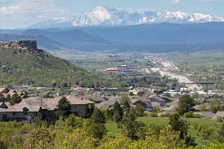
Two Task forces
Arapahoe County
Douglas County
Meets every other Monday 2:00pm
Tri-County Health testing update
Business conference 7-29
Cybersecurity
Hiring, on-boarding and managing virtually
Business Roundtable – Thursday 8-13-20
Meets every other Wednesday 9:00am
Job Fair August 4th
23 Employers
Business referral to Castle Rock resources
Tri-County Health business call

Slide 4
Current projects
CoResponds – Working with Tri-County Health on assisting with Contact Tracer hybrid positions
ReTrain Arapahoe
Working with ACC to develop a close the gap technology training program
COVID-19 related assistance process – Training, supportive services, etc.
NAWDP Apprenticeship – Working with CDLE to develop workforce apprenticeships
Virtual Job Fair Platform – Regional group looking into a platform that will allow large virtual events
COVID -19 Employment – Analyzing top ten companies hiring now

Slide 5
The Hybrid Workplace: Our New Normal?
S. Lorrie Ray, Esq. / Employers Council

Slide 6
Health and safety first
Allow for personal choice when possible
Consider business needs
In the Office vs. Working at Home
How do you choose who continues to work from home?
Notes:
So - how do you choose who continues to work from home.
Health and safety first. Local orders, local health departments, and local case numbers should guide your initial decisions
Allow for personal choice when possible. There may be school conflicts, health issues in the household, or someone who feels very strongly they want to be in the office part or all of the time.
Consider business needs – really and honestly evaluate who has to be physically in the office. Push hard on any reasons that can’t withstand a few “yes, and” questions. Push hard on your belief that work has to happen in the office. Also consider when it would be best for employees to meet face to face. If your workforce is going to work one day a week in the office, make that the day for collaboration and/or socialization.

Slide 7
2019 Pew Research:
58% of Black adults and 57% of Hispanic adults have a laptop or desktop computer compared with 82% of White adults
Bureau of Labor Statistics: those who work remotely tend to be both better educated and wealthier than those who don’t
Per the Economics Policy Institute, Black and Hispanic workers are much less likely to be able to telework
Women are suffering the brunt of the economic fall-out of COVID-19
Equity Issues
A chasm is opening up between those who can work from home, who tend to be knowledge workers, and those who can’t, who tend to be service or healthcare workers.
Notes:
I want to talk about equity. There are a couple of issues here. First there are currently a few categories of workers; those who can and will work from home because their jobs allow for it, those who absolutely can’t, like retail or manufacturing, and those who don’t want to. Throw into the mix school and daycare closures, and now you’ve got an even bigger equity problem. Statistically, people of color occupy the majority of the out of the home jobs, and are not able to work from home. This creates an equity divide. Also statistically, women are the default parent when it comes to child care, remote schooling, etc. and are thus more negatively affected by the current work at home arrangements than men. So again, equity becomes a problem.
The spread of the coronavirus has also highlighted the divide between workers who receive paid sick leave and vacation days, and low-wage workers who don’t get paid if they have to take time off for illness.
Per Forbes: We are witnessing a new version of the opportunity divide unfold across the country, with millions of frontline workers heroically showing up for work every day in grocery stores, providing transportation, working in large distribution centers, and other essential roles needed to keep the country safe and fed.
Alex Baptiste, policy counsel for the nonprofit National Partnership for Women and Families, says the remote work gap is just one way the coronavirus outbreak is underscoring inequalities inherent in the American economy. “On the one hand, you want people to have the best benefits that they possibly can, and when you see that kind of progress, we’re excited about it,” Baptiste says. “But it definitely is showing how wide the gap is between who have it and people who don’t.”
PEW:
By the numbers: Per a 2019 report from Pew Research Center, 58% of Black adults and 57% of Hispanic adults have a laptop or desktop computer, compared with 82% of white adults.
66% of Black adults and 61% of Hispanic adults have broadband access at home. Among white adults, the share is 79%.
BLS: Those who work remotely tend to be both better-educated and wealthier. Among workers ages 25 and older, 47% of workers with a bachelor’s degree or higher worked from home sometimes, according to BLS data, compared to just 3% of workers with only a high school diploma. Of course, some highly educated workers, like medical professionals, also typically have to show up in person for work
EPI:
Less than one in five black workers and roughly one in six Hispanic workers are able to work from home Share of workers who can telework, by race and ethnicity, 2017–2018
Also - According to a recent survey from WayUp, Black and Hispanic job applicants are 145% more likely than their white counterparts to be concerned about their ability to do a job remotely.
"Census data shows that Black households have 20% more people and Hispanic households have 80% more people compared to White households, which can result in concerns about background noise, distractions, as well as the basic concern about lack of space," CNBC's Kelsey Johnson reports.
Women:
60% of employees laid-off due to COVID-19 are women.
Over 50% of working parents have lost childcare and women are most likely the primary caretakers who have to fill the childcare gap.
Many women are considering leaving the workplace due to childcare concerns.

Slide 8
Addressing Equity Issues
Benefits
Pay
Professional and Career Development
Notes:
This difference is going to force employers to address an already widening “us and them” gap.
Compounding the problem is that people in must-show kinds of fields often lack access to benefits like paid sick leave that could keep them from coming to work and potentially spreading an illness to customers and colleagues, says Eileen Appelbaum, co-director of the Center for Economic and Policy Research. “If you get the coronavirus and are quarantined, we’re talking about two weeks, we’re not talking about five days,” Appelbaum says. “And for that, we would have to have paid family and medical leave. And we know how rare that is — only about 20% of all workers have it.”
Employers must take a look at the perceived perks the WAH force gets, and work to balance that. It could mean paid sick leave. PSL means more than just a benefit to employees, it’s also a risk management strategy. Employees with little or no paid sick time, are forced to choose to come to work sick and get paid, or stay home thus keeping their cooties home, but not getting paid. Employees who live on the edge will feel there is no choice, they must go to work.
In that same vein, employees who are better paid, might not feel the pressure of that choice as much either. Higher pay could also bridge the gap of us and them.
Be sure that all employees understand and have access to any professional and career development opportunities. If there aren’t any, make some.
The bottom line is – take a look at the inequities, and find ways to remove them.
Another way to address equity issues is to look at flexible scheduling.

Slide 9
Flexible Scheduling Options: Engage with employees to identify work schedules that meet business and personal needs.
Childcare Support:
Offer guidance to childcare options—ask employees for ideas and proposed solutions.
Intermittent Leave:
Consider allowing employees with pressing childcare needs the option of taking leave and sharing childcare with other family members. Consider if leave under the Families First Coronavirus Response Act (FFCRA) is applicable.
Job Sharing: Multiple employees may need similar accommodations to balance work with home needs, and they may be able to share responsibilities to get the work done on a reduced schedule.
Addressing Equity Issues: Schedules
Notes:
If possible, flexible scheduling can also help equalize things. Employees who work from home have more actual and perceived flexibility in their scheduling. I can take 15 minutes to do a load of laundry, or prep for dinner, or pick up a room. I can also shift my schedule to accommodate a walk or a workout. That is a privilege of working from home. To level that playing field, employers should create more flexibilitiy. Can the work shift, shift so that ees can run errands, etc. If not, what would work for your employees.

Slide 10
Technological and Operational Needs
Not all of our employees have good internet, good security, good office setups
Ergonomics
School and daycare closures – how do we support staff
Illness and care
Notes:
Address internet – are you going to offer to pay for better internet? How are you addressing cybersecurity with your remote workforce ?
Ergonomics – not many employers are addressing ergonomics with their remote workforce. There was a time in March and early April when I was working on my couch, either with my laptop literally on my raised knees like a chez lounge posture, or with my laptop on the couch, my legs folded criss-cross- applesauce, my body hunched over the computer. It only took a month for me to feel stiff every time I stood up.
Consider using your wellness committee/communications to address ergonomics. Or consider publishing some tips. You can incentivize it through rewards or competition. Here are some suggestions:
The ergonomics design of the computer workstation is applicable in the office environment and wherever you find yourself working. How you set up the space and work has a big impact on reducing the use of awkward postures and for the risk of injury. Here are some ergonomics tips to follow*.
Create a Dedicated Workspace • Identify a space with a desk or table that can be dedicated for computer use; do not work while sitting on a bed or couch for long periods of time
o Monitor: Use a separate monitor, if using a laptop place on a stand or books
o Keyboard and mouse: Use a traditional set-up, hook laptop directly to monitor or place laptop on stand and use an external keyboard and mouse
o Chair: Use a chair with low back support and seated cushion; for a kitchen or dining chair insert a seat cushion and roll up a soft towel or blanket to place in your low back area
o Phone: Use the speakerphone or microphone/voice activation for cell phone texting; don’t brace the handset or cell phone between the neck and shoulder
Leave Food in the Kitchen To help allow enough space to use computer equipment properly, especially the keyboard and mouse, try keeping food in the kitchen. Having two distinct spaces will allow for focused time to work and enjoyable time to eat.
Use Ample Natural Lighting Create the dedicated work area with as much natural lighting as possible. Don’t tuck it away in a dark corner, but instead use good lighting to improve performance. Use lamps where needed. Place the work area perpendicular to windows to reduce glare. Keep in mind the monitor should be the brightest thing in the space.
Drink Lots of Water and Take Breaks Throughout the Day Drink water consistently throughout the day. Take movement breaks every half hour and change postures when starting to fatigue. Try to find ways to stand and alternate job tasks for short periods of time.
School: Employers are bracing for the possibility that employees will be absent part or all of the time because they have nowhere to safely send their kids. Individual school districts have individual plans, compounding the problem. Some schools will be going back to the classroom full time, some doing a hybrid of in-person and online, some 100% virtual. And all of the plans are subject to change based on COVID numbers; federal, state, and local health orders; positive tests in a school or classroom; and so on. Because school, childcare, and job responsibilities will be intertwined for many working parents for the foreseeable future, employers should plan for the long haul. Instead of patching together interim plans, employers might want to consider looking at this as a long term need. Also, childcare and schools will be affected by the economic hit of COVID-19 just as much as the rest of us. Childcare, like the hospitality and entertainment industries, will need to adjust accordingly. This pandemic is likely to change the way childcare and the workplace look for a long time to come.
The flexible scheduling options above are a good place to start. Communication and coming to an agreement will also be important. Finally, don’t force your employees to sneak. The same goes for illness or caring for an ill family member.

Slide 11
Legal Needs
OSHA
Follow OSHA Guidance
General Duty Standard – Look to CDC
Notes:
OSHA is pretty lenient about inspecting home offices. From the website it says “OSHA respects the privacy of the home and has never conducted inspections of home offices. While respecting the privacy of the home, it should be kept in mind that certain types of work at home can be dangerous/hazardous. Examples of such work from OSHA's past inspections include: assembly of electronics; casting lead head jigs for fishing lures; use of unguarded crimping machines; and handling adhesives without protective gloves.” It also says: “Employers who are required, because of their size or industry classification, by the OSH Act to keep records of work-related injuries and illnesses, will continue to be responsible for keeping such records, regardless of whether the injuries occur in the factory, in a home office, or elsewhere, as long as they are work-related, and meet the recordability criteria of 29 CFR Part 1904.
Other than clarifying the policy on inspections and procedures concerning home-based worksites, this instruction does not alter or change employers' obligations to employees.”
You will need to contact your workers comp provider to see if you need any additional coverage for remote workers, what the requirments are, etc.
ADA – while there are some covid specific ADA considerations, this presentation is about the long haul. You can check the eeo website entitled what-you-should-know-about-covid-19-and-ada-rehabilitation-act-and-other-eeo-laws for more covid specific information. Going forward, employers covered by the ADA will continue to be covered. The interactive process won’t change, and work from home may be a reasonable accommodation for employees with some disabilities.
Again – for the duration of the pandemic, you will want to be familiar with the Families First Coronavirus Recovery Act, and any legislation that comes out in the next few months. For the long haul, however, some states are starting to pass, or already have paid sick leave laws. For example, AZ and CA have had paid sick leave laws for a while now. CO has just passed its own. Employers should become, or should already be, familiar with state and local leave laws.
Wage and hour – employers will need to be extra vigilant about non-exempt employees. The overtime laws, state or federal, still apply, and non-exempt employees need to be paid for all time worked. It will be crucial for employers to find a way to track hours accurately, and to discuss if employees are working too many hours, or not reporting all hours worked. There are a lot of technology options that allow you to do this without actually microchipping your employees. ☺ Start with your payroll provider or timekeeping system. They might already have things in place that will work for you. And be prepared for some performance management discussions as well.

Slide 12
Legal Needs
Workers compensation
Employee claims COVID19 from work
This is why you have insurance
Call carrier let them decide
Notes:
OSHA is pretty lenient about inspecting home offices. From the website it says “OSHA respects the privacy of the home and has never conducted inspections of home offices. While respecting the privacy of the home, it should be kept in mind that certain types of work at home can be dangerous/hazardous. Examples of such work from OSHA's past inspections include: assembly of electronics; casting lead head jigs for fishing lures; use of unguarded crimping machines; and handling adhesives without protective gloves.” It also says: “Employers who are required, because of their size or industry classification, by the OSH Act to keep records of work-related injuries and illnesses, will continue to be responsible for keeping such records, regardless of whether the injuries occur in the factory, in a home office, or elsewhere, as long as they are work-related, and meet the recordability criteria of 29 CFR Part 1904.
Other than clarifying the policy on inspections and procedures concerning home-based worksites, this instruction does not alter or change employers' obligations to employees.”
You will need to contact your workers comp provider to see if you need any additional coverage for remote workers, what the requirments are, etc.
ADA – while there are some covid specific ADA considerations, this presentation is about the long haul. You can check the eeo website entitled what-you-should-know-about-covid-19-and-ada-rehabilitation-act-and-other-eeo-laws for more covid specific information. Going forward, employers covered by the ADA will continue to be covered. The interactive process won’t change, and work from home may be a reasonable accommodation for employees with some disabilities.
Again – for the duration of the pandemic, you will want to be familiar with the Families First Coronavirus Recovery Act, and any legislation that comes out in the next few months. For the long haul, however, some states are starting to pass, or already have paid sick leave laws. For example, AZ and CA have had paid sick leave laws for a while now. CO has just passed its own. Employers should become, or should already be, familiar with state and local leave laws.
Wage and hour – employers will need to be extra vigilant about non-exempt employees. The overtime laws, state or federal, still apply, and non-exempt employees need to be paid for all time worked. It will be crucial for employers to find a way to track hours accurately, and to discuss if employees are working too many hours, or not reporting all hours worked. There are a lot of technology options that allow you to do this without actually microchipping your employees. ☺ Start with your payroll provider or timekeeping system. They might already have things in place that will work for you. And be prepared for some performance management discussions as well.

Slide 13
Legal Needs
ADA
Employee Cannot Return to Work
Employee Claims about Masks
Notes:
OSHA is pretty lenient about inspecting home offices. From the website it says “OSHA respects the privacy of the home and has never conducted inspections of home offices. While respecting the privacy of the home, it should be kept in mind that certain types of work at home can be dangerous/hazardous. Examples of such work from OSHA's past inspections include: assembly of electronics; casting lead head jigs for fishing lures; use of unguarded crimping machines; and handling adhesives without protective gloves.” It also says: “Employers who are required, because of their size or industry classification, by the OSH Act to keep records of work-related injuries and illnesses, will continue to be responsible for keeping such records, regardless of whether the injuries occur in the factory, in a home office, or elsewhere, as long as they are work-related, and meet the recordability criteria of 29 CFR Part 1904.
Other than clarifying the policy on inspections and procedures concerning home-based worksites, this instruction does not alter or change employers' obligations to employees.”
You will need to contact your workers comp provider to see if you need any additional coverage for remote workers, what the requirments are, etc.
ADA – while there are some covid specific ADA considerations, this presentation is about the long haul. You can check the eeo website entitled what-you-should-know-about-covid-19-and-ada-rehabilitation-act-and-other-eeo-laws for more covid specific information. Going forward, employers covered by the ADA will continue to be covered. The interactive process won’t change, and work from home may be a reasonable accommodation for employees with some disabilities.
Again – for the duration of the pandemic, you will want to be familiar with the Families First Coronavirus Recovery Act, and any legislation that comes out in the next few months. For the long haul, however, some states are starting to pass, or already have paid sick leave laws. For example, AZ and CA have had paid sick leave laws for a while now. CO has just passed its own. Employers should become, or should already be, familiar with state and local leave laws.
Wage and hour – employers will need to be extra vigilant about non-exempt employees. The overtime laws, state or federal, still apply, and non-exempt employees need to be paid for all time worked. It will be crucial for employers to find a way to track hours accurately, and to discuss if employees are working too many hours, or not reporting all hours worked. There are a lot of technology options that allow you to do this without actually microchipping your employees. ☺ Start with your payroll provider or timekeeping system. They might already have things in place that will work for you. And be prepared for some performance management discussions as well.

Slide 14
Legal Needs
Cross-state employment
New Opportunities
New Requirements
Payroll Tax
State Laws
Notes:
OSHA is pretty lenient about inspecting home offices. From the website it says “OSHA respects the privacy of the home and has never conducted inspections of home offices. While respecting the privacy of the home, it should be kept in mind that certain types of work at home can be dangerous/hazardous. Examples of such work from OSHA's past inspections include: assembly of electronics; casting lead head jigs for fishing lures; use of unguarded crimping machines; and handling adhesives without protective gloves.” It also says: “Employers who are required, because of their size or industry classification, by the OSH Act to keep records of work-related injuries and illnesses, will continue to be responsible for keeping such records, regardless of whether the injuries occur in the factory, in a home office, or elsewhere, as long as they are work-related, and meet the recordability criteria of 29 CFR Part 1904.
Other than clarifying the policy on inspections and procedures concerning home-based worksites, this instruction does not alter or change employers' obligations to employees.”
You will need to contact your workers comp provider to see if you need any additional coverage for remote workers, what the requirments are, etc.
ADA – while there are some covid specific ADA considerations, this presentation is about the long haul. You can check the eeo website entitled what-you-should-know-about-covid-19-and-ada-rehabilitation-act-and-other-eeo-laws for more covid specific information. Going forward, employers covered by the ADA will continue to be covered. The interactive process won’t change, and work from home may be a reasonable accommodation for employees with some disabilities.
Again – for the duration of the pandemic, you will want to be familiar with the Families First Coronavirus Recovery Act, and any legislation that comes out in the next few months. For the long haul, however, some states are starting to pass, or already have paid sick leave laws. For example, AZ and CA have had paid sick leave laws for a while now. CO has just passed its own. Employers should become, or should already be, familiar with state and local leave laws.
Wage and hour – employers will need to be extra vigilant about non-exempt employees. The overtime laws, state or federal, still apply, and non-exempt employees need to be paid for all time worked. It will be crucial for employers to find a way to track hours accurately, and to discuss if employees are working too many hours, or not reporting all hours worked. There are a lot of technology options that allow you to do this without actually microchipping your employees. ☺ Start with your payroll provider or timekeeping system. They might already have things in place that will work for you. And be prepared for some performance management discussions as well.

Slide 15
Legal Needs
FFCRA and Colorado Law
Intermittent Leave
If 500 or more
Extra 80 hours
If fewer than 500
How much have you paid
Notes:
OSHA is pretty lenient about inspecting home offices. From the website it says “OSHA respects the privacy of the home and has never conducted inspections of home offices. While respecting the privacy of the home, it should be kept in mind that certain types of work at home can be dangerous/hazardous. Examples of such work from OSHA's past inspections include: assembly of electronics; casting lead head jigs for fishing lures; use of unguarded crimping machines; and handling adhesives without protective gloves.” It also says: “Employers who are required, because of their size or industry classification, by the OSH Act to keep records of work-related injuries and illnesses, will continue to be responsible for keeping such records, regardless of whether the injuries occur in the factory, in a home office, or elsewhere, as long as they are work-related, and meet the recordability criteria of 29 CFR Part 1904.
Other than clarifying the policy on inspections and procedures concerning home-based worksites, this instruction does not alter or change employers' obligations to employees.”
You will need to contact your workers comp provider to see if you need any additional coverage for remote workers, what the requirments are, etc.
ADA – while there are some covid specific ADA considerations, this presentation is about the long haul. You can check the eeo website entitled what-you-should-know-about-covid-19-and-ada-rehabilitation-act-and-other-eeo-laws for more covid specific information. Going forward, employers covered by the ADA will continue to be covered. The interactive process won’t change, and work from home may be a reasonable accommodation for employees with some disabilities.
Again – for the duration of the pandemic, you will want to be familiar with the Families First Coronavirus Recovery Act, and any legislation that comes out in the next few months. For the long haul, however, some states are starting to pass, or already have paid sick leave laws. For example, AZ and CA have had paid sick leave laws for a while now. CO has just passed its own. Employers should become, or should already be, familiar with state and local leave laws.
Wage and hour – employers will need to be extra vigilant about non-exempt employees. The overtime laws, state or federal, still apply, and non-exempt employees need to be paid for all time worked. It will be crucial for employers to find a way to track hours accurately, and to discuss if employees are working too many hours, or not reporting all hours worked. There are a lot of technology options that allow you to do this without actually microchipping your employees. ☺ Start with your payroll provider or timekeeping system. They might already have things in place that will work for you. And be prepared for some performance management discussions as well.

Slide 16
Legal Needs
Wage and hour
Compressed Schedules and Colorado Law
Public Sector Employers Can Furlough Exempt
Private Sector Exempt Concerns
Notes:
OSHA is pretty lenient about inspecting home offices. From the website it says “OSHA respects the privacy of the home and has never conducted inspections of home offices. While respecting the privacy of the home, it should be kept in mind that certain types of work at home can be dangerous/hazardous. Examples of such work from OSHA's past inspections include: assembly of electronics; casting lead head jigs for fishing lures; use of unguarded crimping machines; and handling adhesives without protective gloves.” It also says: “Employers who are required, because of their size or industry classification, by the OSH Act to keep records of work-related injuries and illnesses, will continue to be responsible for keeping such records, regardless of whether the injuries occur in the factory, in a home office, or elsewhere, as long as they are work-related, and meet the recordability criteria of 29 CFR Part 1904.
Other than clarifying the policy on inspections and procedures concerning home-based worksites, this instruction does not alter or change employers' obligations to employees.”
You will need to contact your workers comp provider to see if you need any additional coverage for remote workers, what the requirments are, etc.
ADA – while there are some covid specific ADA considerations, this presentation is about the long haul. You can check the eeo website entitled what-you-should-know-about-covid-19-and-ada-rehabilitation-act-and-other-eeo-laws for more covid specific information. Going forward, employers covered by the ADA will continue to be covered. The interactive process won’t change, and work from home may be a reasonable accommodation for employees with some disabilities.
Again – for the duration of the pandemic, you will want to be familiar with the Families First Coronavirus Recovery Act, and any legislation that comes out in the next few months. For the long haul, however, some states are starting to pass, or already have paid sick leave laws. For example, AZ and CA have had paid sick leave laws for a while now. CO has just passed its own. Employers should become, or should already be, familiar with state and local leave laws.
Wage and hour – employers will need to be extra vigilant about non-exempt employees. The overtime laws, state or federal, still apply, and non-exempt employees need to be paid for all time worked. It will be crucial for employers to find a way to track hours accurately, and to discuss if employees are working too many hours, or not reporting all hours worked. There are a lot of technology options that allow you to do this without actually microchipping your employees. ☺ Start with your payroll provider or timekeeping system. They might already have things in place that will work for you. And be prepared for some performance management discussions as well.

Slide 17
Ongoing Mental and Physical Health
Notes:
I saw a post on FB recently that said “One of the best parts of 2020 is the constant feeling that you’re being an over-reacting weirdo but also, impossibly, that at the same time you’re not taking it seriously enough, are taking too many risks, and that you might die or kill your family because of them.
THIS IS ALL GREAT FOR MENTAL HEALTH.”
Yes. This.
We can’t live like we did before coronavirus. We won’t live like we did immediately after it appeared, either. Instead, we’re in the muddy middle, faced with choices that seem at once crucial and impossible, simple and massively complicated. These choices are an everyday occurrence, but they also carry a moral weight that makes them feel different than picking a pasta sauce or a pair of shoes. In a pandemic that’s been filled with unanswerable questions and unwinnable wars, this is our daily Kobayashi Maru – a start trek reference for you geeks out there. It is a test of start fleet cadets in which there is a no-win scenario, and they have to choose anyway. . And no one can tell us exactly what we ought to do. All of us face this in some way or another with almost every move we make. Our employees feel it, and as employers, we have the added pressure of our employees’ wellbeing in our decision making. We have all been at alert levels for months, and we are tired.
And this won’t just end. It’s important to remember that the mental health of our employees will also continue to be prevelant in our workplaces. Greif lasts, and we will all be greiveing something, the loss of a family member or friend, the loss of our comfortable routines we’ve had for years, the loss of a sense of security that happened when everything shifted in a week, the loss of a partner’s job, the loss of childhood milestones or events.
Mostly I am bringing this up to remind us all to be a little kinder. Business is not as usual, and for a lot of us, our normal coping mechanisms are not available. For me, I tend to recharge by going to a concert, a play, a movie, or a baseball game. I am an extrovert and crowded live events feed my energy and my psyche. Finding replacements for those, when I know that the return date of any of those things is unknown. For others it’s a gym, or museum, or a family reunion. You can support your employees by not only being more compassionate, but also making sure they know their options, like an EAP, or online workout programs that are free or covered by insurance, etc.

Slide 18
S. Lorrie Ray
Lray@EmployersCouncil.org

Slide 19
Economic Recovery Snapshot
Week of August 3, 2020

Slide 20
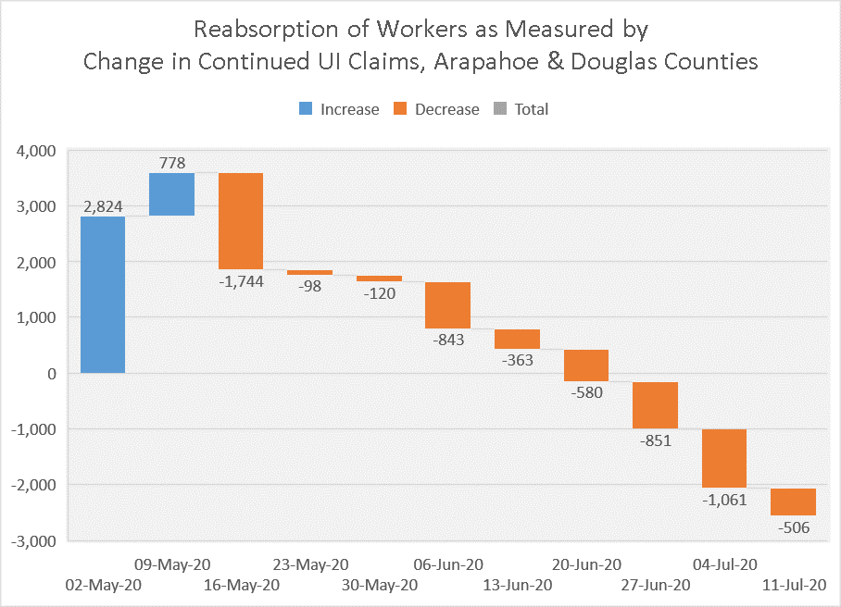
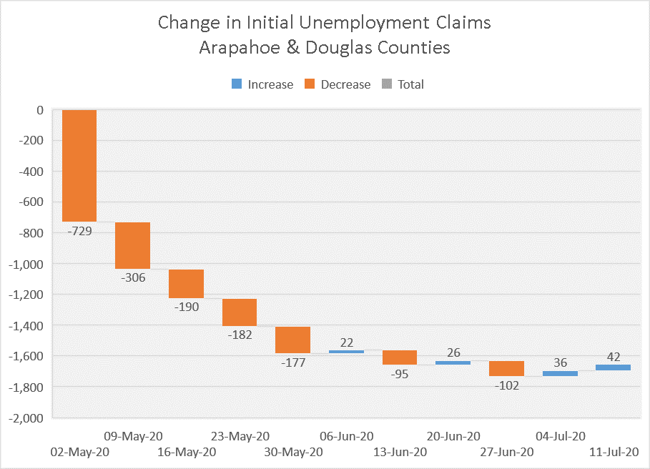
Recovery Progression
These waterfall graphs show the downward trends week over week in both initial continued unemployment claims in Arapahoe and Douglas counties, with a slight rise in initial claims. The fact that continued claims (left graph) have gone down nine weeks in a row suggests people are returning to work slowly.
For perspective, the week of July 11, 2020, there were 38,674 continuing unemployment insurance claims in the two-county region.

Slide 21
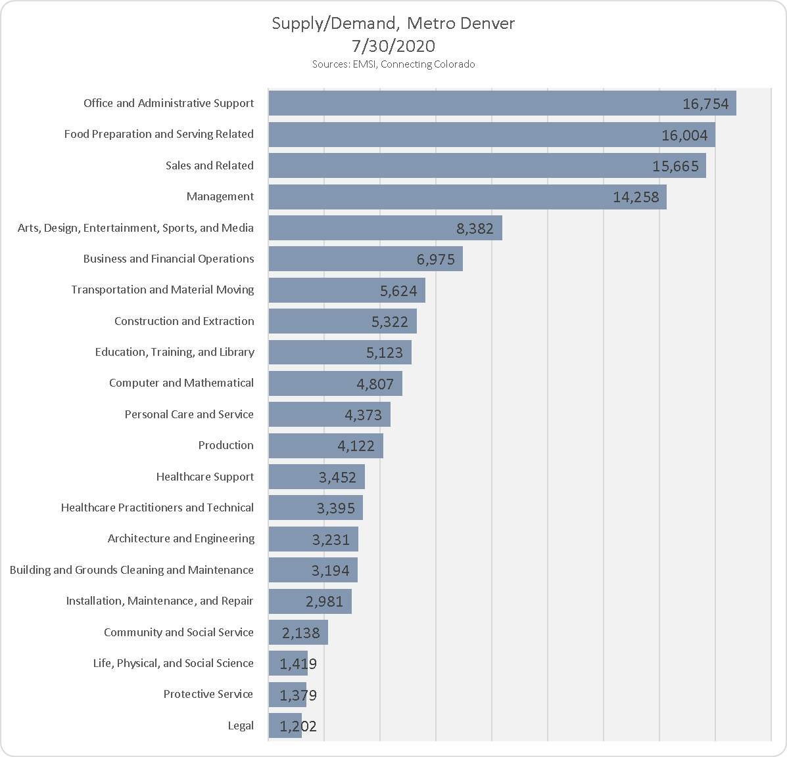
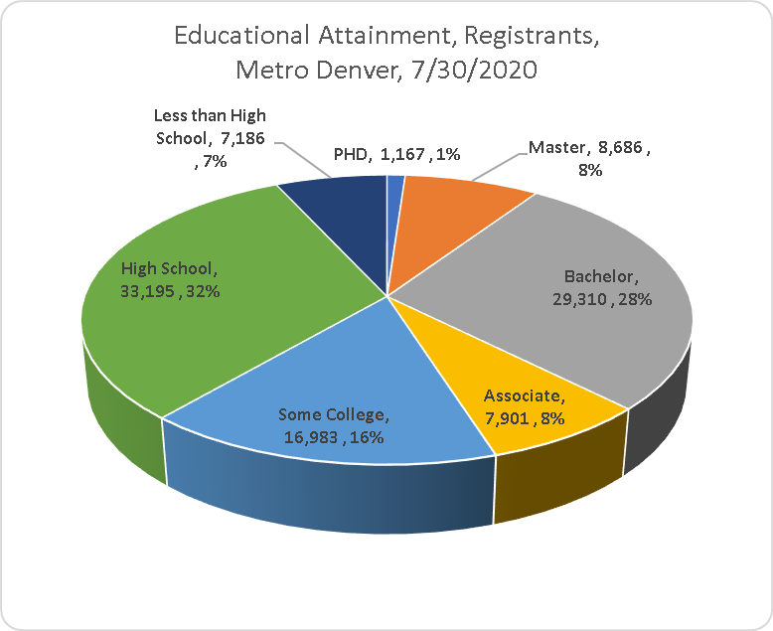
Current Registrants at Arapahoe/Douglas Works! Customer Base
These graphs show the Connecting Colorado registrants in greater metro Denver. These are people being served by the workforce system in the region, including Arapahoe/Douglas Works!
Notes:
There are presently 104,428, in Connecting Colorado in greater metro Denver, up from 102,890 July 16.
There is duplication because the system assigns up to four occupation codes, depending on skills. The current average is 1.24.

Slide 22
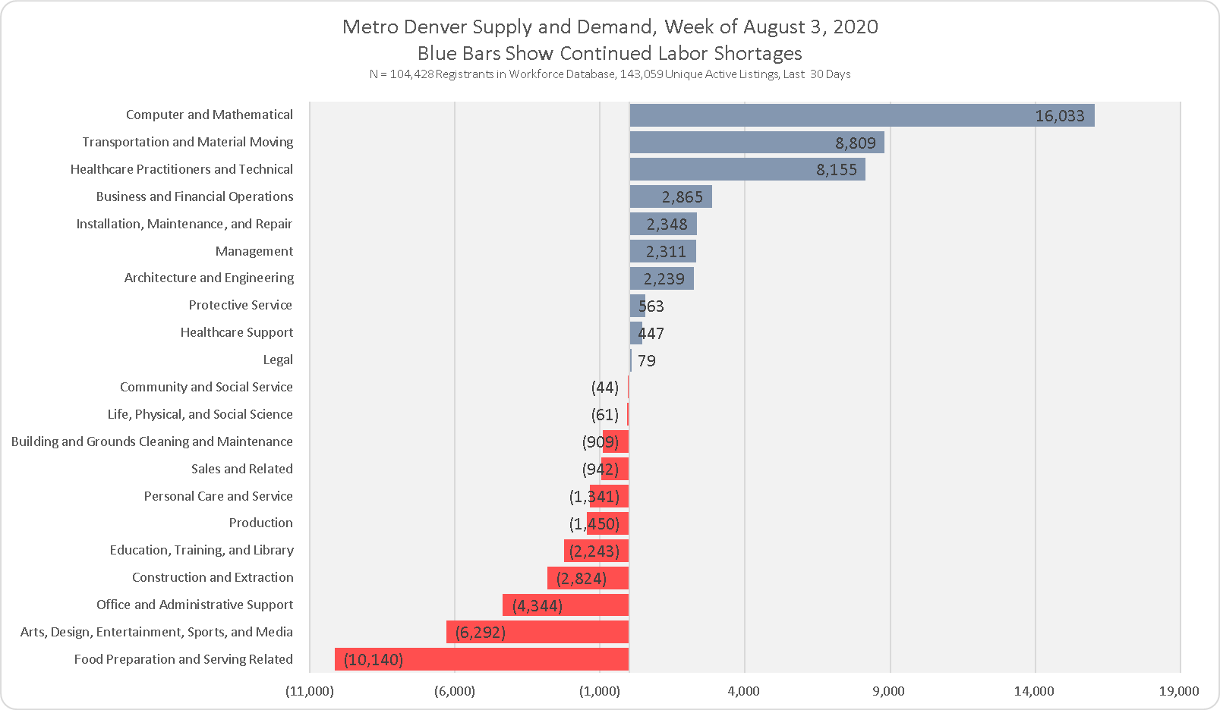
Continued Labor Shortages
This graph is taken from the one on the last slide. It gives a stark view of the labor shortages being experienced right now. It is difference between the point-in-time number of job seekers available through the workforce system and unique active job postings in the last thirty days by occupation family. As a result of discussions with several stakeholders, who felt the number of job listings over the past 30 days gives the viewer a better perspective, the timeframe on listings was changed from the seven days reflected last week.

Slide 23
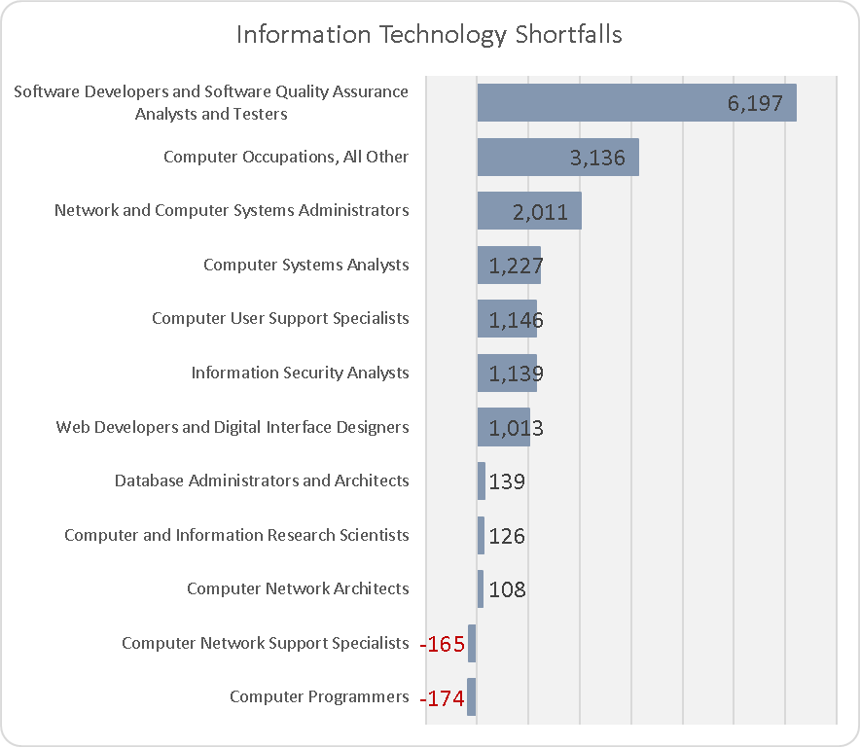
Computer Occupation Shortages
Due to scheduled updates in the Bureau of Labor Statistics (BLS) Occupational Employment Statistics (OES) survey, Software Developers, Applications, Software Developers, Systems, and Software QA and Testing were all rolled into one Standard Occupational Classification (SOC) code.
The Bureau of Labor Statistics will roll out its new 2018 SOC rubric early next year, when the three consolidated occupations are expected to be separated once again.
This bar graph shows the same thing as the previous slide, except that it drills down into computer occupations, which is the grouping with the greatest labor shortage.
For example, we would read, “In greater metro Denver, there are 6,197 more job postings for Software Developers and Software Quality Assurance Analysts and Testers than people to fill those jobs.”

